Slide 1
Web Analytics

Slide 2
Initiation into the Intent of Web Analytics
The first thing that comes to one's mind after creating a website is the number of visitors that it can generate. More important is the fact that these visitors become customers or lead subscribers. The goal should be in understanding the behaviour of website customers. Our viewpoint should be in creating a lucrative occurrence on the web, and finding out how to convert these visitors into loyal customers. Web Analytics is the study of data on web traffic that is collected, and aspects of the website that work towards generating more business, which are planned and implemented.

Slide 3
History Of Web Analytics
In 90’s web server log files-recorded visits per site.
The history of web analytics began with simple hit counters that became a fad in the mid 1990’s
With the Introduction of the Google Analytics ,all companies and bloggers are able to take power of web analytic for free.

Slide 4
Why we need web analytics?
Offline Marketing has no accountability and there is no way of measuring success or failure of the efforts that are invested.
To understand how your visitors interact with your website
So you can learn how to improve your visitors’ site experience
To view how people are arriving on your website and from what sources
To see which pages are performing best and how to improve them in order to convert customers
So you can learn from them and tweak your website to become a marketing machine!

Slide 5
What is Web Analytics?
Web analytics is a generic term meaning the study of the impact of a website on its users
Web analytics is the process of analysing the behaviour of visitors to a Website.
Web Analytics is the measurement, collection, analysis and reporting of Internet data for the purposes of understanding and optimizing Web usage.

Slide 6
Who uses Web Analytics
Server Administrator,
Product Manager,
Web Designer,
Software Architects and
Marketers.

Slide 7
How to get Google Analytics on your site
First Creating a goggle account or already you have account ,Please Sign in into Google Analytics.
Getting the code
Placing the code on your website.
Collecting data.

Slide 8
Types Of Web Analytics
1.On-Site Web analytics:
Web traffic information on a particular website. This is the information
collected After a user reached the website.(Ex.Cricbuzz)
2.Off-Site web analytics:
Web traffic information on the internet as a whole.(Ex.Virat Kohli)

Slide 9
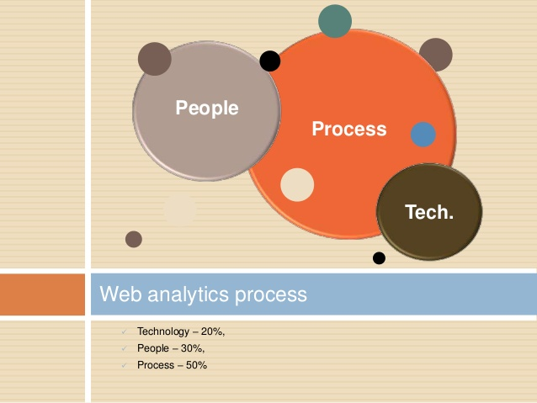

Slide 10
Web Analytics Process

Slide 11
Web Analytics technologies
Log File analysis
Logfile analysis is usually already available in the server (Web servers log their activity by default).
Page Tagging(cookies)
Page tagging is an outsourced option, which means that visitors’ data is captured by provider’s remote server. You can view them only in provider’s website.
It is otherwise called as client side tagging. Page Tagging uses a small snippet of code (normally JavaScript) that you add to each of your web pages that you wish to monitor.

Slide 12
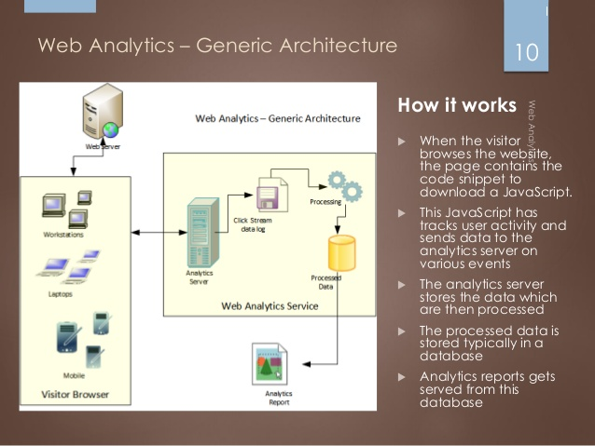
Web Analytics Architecture

Slide 13
Web Analytics Software
Web analytic software can also be used to monitor whether or not a site's pages are working properly. With this information, Web site administrators can determine which areas of the site are popular and which areas of the site do not get traffic
Some Web Analytics Software are,
1.Analog,
2.Awstats

Slide 14
Benefits of Web Analytics
Know your visitors
Track where traffic is coming from
Gauge the success of other marketing activities and see your match rate rise.
See where you are losing customers.
Know exactly what your customers are looking for.
Find out how to optimise your website

Slide 15
Web Analytic Tools
Google Analytics
Clicky
Mint
Church Analytics
KISSmetrics
Open Web Analytics
Clicktale
CrazyEgg
Piwik
CloudFlare

Slide 16
Google Analytics
Introduction

Slide 17
What is Google Analytics
Google Analytics is the World’s Most Popular Web Analytics Tool
Google Analytics is a free web analytics tool that generates detailed statistics about activity on a website
Google Analytics is a free Web Analytics service that provides statistics and basic analytical tools for search engine optimization (SEO) and marketing purposes.

Slide 18
Google Analytics-What Does it do?
Google Analytics is powerful tool that analyzses
Website Traffic
Track Conversion
E-commerce
AdWords Performance

Slide 19
How it works?

